Slide 1
Microservices

Slide 2

Revision: What is a service?
When you perform a keyword search in Google, Google gives you the result.
=> Google is providing a search engine service.
When you turn on Uber, Uber show you nearby drivers.
=> Uber is providing a driver location service.
A service usually means to perform a task upon request.

Slide 3
How is this related to Data Engineers?
Build / Use Data Exchange services
Productize data products
Reusable infrastructure for internal tools
POC / Experimentation

Slide 4
Case Study - Coffee Shop Example
Which component will visited frequently?
Which kind of resources (e.g. CPU, RAM, Network, Storage) is the most intensive for each component?
How about effort (SLA, Security, Update Frequency)
What happens when I add new component / new features to support business growth?
What if the Relational Database is down?
What if I want to try out new technologies?
The Monolith Application
Product (Menu)
Barista
Counter (Order)
Kitchen
Relational Database
Example Credits to Thang Chung https://github.com/thangchung/coffeeshop-modular

Slide 5
The API Mandate from Jeff Bezos
All teams will henceforth expose their data and functionality through service interfaces.
Teams must communicate with each other through these interfaces.
There will be no other form of interprocess communication allowed: no direct linking, no direct reads of another team’s data store, no shared-memory model, no back-doors whatsoever. The only communication allowed is via service interface calls over the network.
It doesn’t matter what technology they use. HTTP, Corba, Pubsub, custom protocols — doesn’t matter. Bezos doesn’t care.
All service interfaces, without exception, must be designed from the ground up to be externalizable. That is to say, the team must plan and design to be able to expose the interface to developers in the outside world. No exceptions.
Anyone who doesn’t do this will be fired.

Slide 6
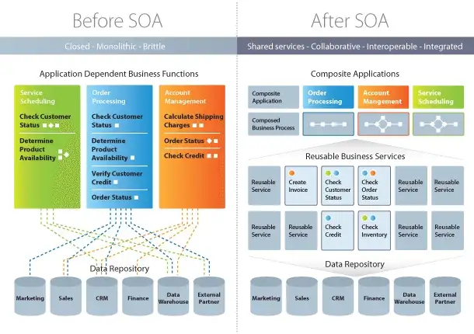
Service Oriented Architecture (SOA)
https://medium.com/@SoftwareDevelopmentCommunity/what-is-service-oriented-architecture-fa894d11a7ec

Slide 7
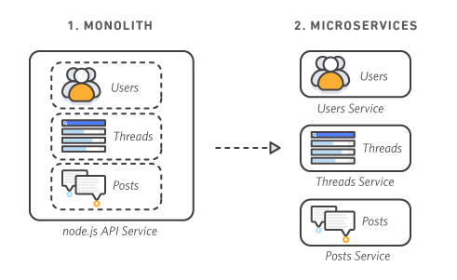
What is microservice?
https://aws.amazon.com/tw/microservices/

Slide 8
Cloud Computation Services
Level | On GCP | On AWS
Function | Cloud Function | Lambda
Application | App Engine | Elastic Beanstalk (EB)
Docker Image | Cloud run / App Engine | Elastic Container Service (ECS)
Kubernetes Cluster | Google Kubernetes Engine (GKE) | Elastic Kubernetes Service (EKS)

Slide 9
Considerations to choose between services
There is not one service fits all case, Here are some possible considerations:
Complexity of the service | App Engine
Integration with the Cloud Service | A lot of GCP services provide ways to trigger Cloud Functions
Language Choices | Not all languages are supported on each service
Control vs. Ease of use | Cloud Function gives you less control
Personal preference | Whether you need the control/freedom. Familiarity with the services
Other opinion: https://www.sphereinc.com/blogs/when-to-choose-app-engine-vs-cloud-functions-or-cloud-run-in-gcp

